Slide 1
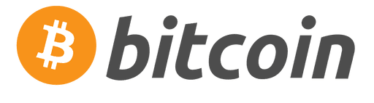

EPIC vs BTC HALVING PRICE PERFORMANCE
866% INCREASE
2ND HALVING
13% INCREASE
1ST HALVING
12the Aug 2020 v01

